Slide 1
Welcome to Mrs. Smith’s Class
Math - Team 81

Slide 2
About Mrs. Smith
Bachelors degree from GVSU
Major in Biology
Minor in Math
“Almost” Masters degree in school counseling (GVSU)
Master degree in middle level math (this past December)
Still trucking along taking courses ☺
Started at Grandville 11 years ago
Currently teach
1 Honors Geometry Section
2 Math 8 Sections
1 Math Lab Section
2 Algebra Sections

Slide 3
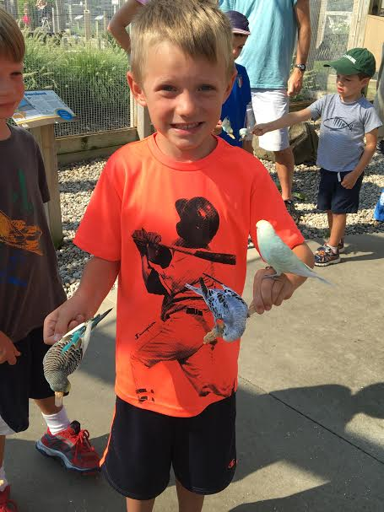
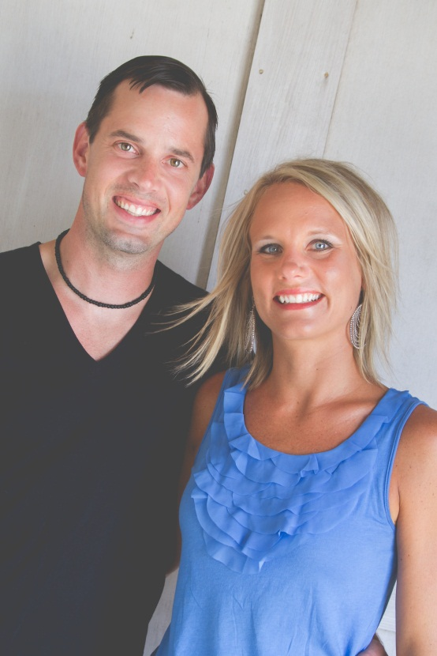
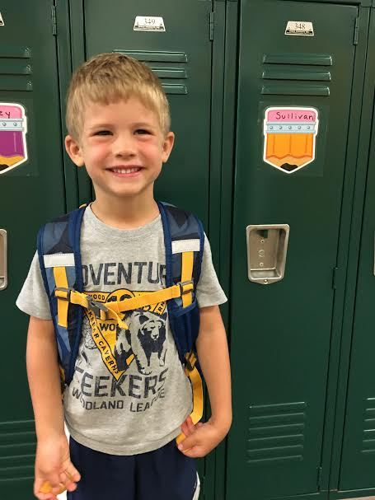
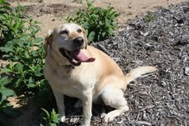
My family

Slide 4
Teaching Style
Inquiry Based Learning
Much different than typical “process learning”
Students must “understand” the “what and why’s” of the content not just the “how”
Students will discover the concepts, answers will not be given to them
May be difficult for students
Relational
Building relationships and respect is one of the only ways to reach all students.
If you have any insights that would help me know your child better, please share with me.

Slide 5
Why is Inquiry Based Instruction Important
Students retain information
If the student understands the “why and what” they have a greater chance of retaining the information and recalling it later. Will not require memorization rather understanding.
Standards
Common Core state standards encourage students to become problem solvers and higher level thinkers
Standardized testing will be based on CC standards and if students are used to just process, test will be difficult

Slide 6
How to monitor child's learning
Talk to your kids - strive for student responsibility
Infinite Campus
My Website
www.mrssmithbulldogmath.weebly.com
Homework Answers
Calendar of Assignments
Frequently asked questions
Contact Information
Syllabus
Team Website
www.gmsteam81.weebly.com

Slide 7
Classroom Letter
Highlights
Study Table
Offered every morning from 7:30 – 7:55
No need for an appointment. Just come on in!
Afternoons if arranged ahead of time
Grading
80% is summative – tests & quizzes
20% is formative – Daily assignments, homework, checkpoint quizzes

Slide 8
High School Credit Bearing Courses
Test Retakes
For tests only (excludes quizzes and exams)
Can do 1 per trimester
Student needs to have 100% of homework turned in
Must correct previous test with written justification for each problem missed
Must be taken within 5 days of original test being passed back
Student will receive the higher of the two grades

Slide 9
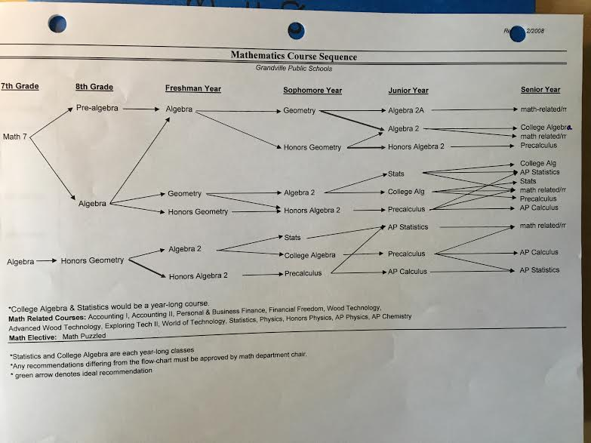
Class flow

Slide 10
Technology
Geogebra
Google Classroom
Formative Assessments
Performance Tasks
Video Tutorials
Checking homework
Flipped Classroom
Class collaboration
Multiple Representations of Concepts

Slide 11
Classroom Flow
Launch
Explore
Explain
Math Journals

Slide 12
How can you help?
GLUE STICKS
CLOROX WIPES

Slide 13
I am looking forward to a GREAT year!
Any Questions?

